Slide 1
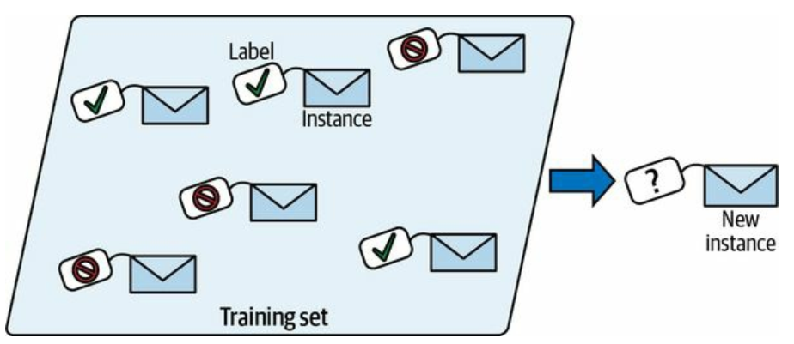
Supervised Learning: Classification
Classification in machine learning is a type of supervised learning where the goal is to categorize or classify data points into predefined classes or labels.
Given input data (features), a classification algorithm learns a mapping function that assigns a label (or class) to each data point based on the training data. It is used when the output variable is categorical, meaning it falls into one of several distinct categories.
Examples of Classification Algorithms:
Logistic Regression
K-Nearest Neighbors (KNN)
Decision Trees
Naive Bayes
Support Vector Machine (SVM)
Random Forest
Neural Networks

Slide 2
Supervised Learning: Classification
K-Nearest Neighbors (KNN)
It is a simple, non-parametric, instance-based machine learning algorithm. It can be also used as regression tasks.
Non-parametric: k-NN doesn’t assume any specific form for the underlying data distribution, which makes it flexible for various data types. It can model complex data patterns without needing to fit data to a predefined parameterized function.
Instance-based: Instead of learning a general rule from the training data, k-NN memorizes the entire training set. For prediction, it looks up the k closest instances in the training data (based on a distance metric like Euclidean or Manhattan) and uses those instances to classify new points or make regression predictions.

Slide 3
Supervised Learning: Classification
K-Nearest Neighbors (KNN)
KNN works by finding the "k" closest data points (neighbors) to a new, unknown data point and making predictions based on their classes.
KNN does not build a model during the training phase. Instead, it stores the training data and makes predictions by referencing it directly during testing. This is why it is also called a lazy learner.
Advantages of KNN:
KNN is easy to understand and implement. Since KNN doesn’t build a model, the training phase is fast. It can be used for both classification and regression problems. KNN doesn’t make assumptions about the underlying data distribution (Non-parametric).

Slide 4
Supervised Learning: Classification
How KNN Works:
Select k Neighbors: The parameter "k" refers to the number of nearest neighbors to consider when making a prediction.
Calculate Distance: The algorithm calculates the distance between the new data point and all other points in the training dataset. Common distance metrics include: Euclidean Distance, Manhattan Distance.
Identify Nearest Neighbors: After calculating the distances, the algorithm selects the k nearest points (neighbors) from the training set.
Make a Prediction: Classification: The new point is assigned to the class that is most common among its k nearest neighbors (majority voting).

Slide 5
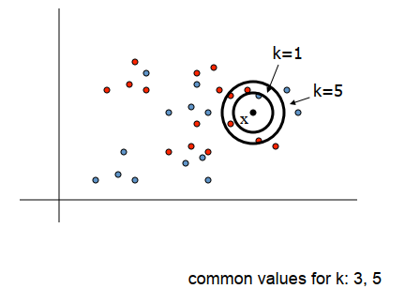
Supervised Learning: Classification
To classify a new input vector x, examine the k-closest traning data point to x and assign the object to the most frequently occurring class.

Slide 6
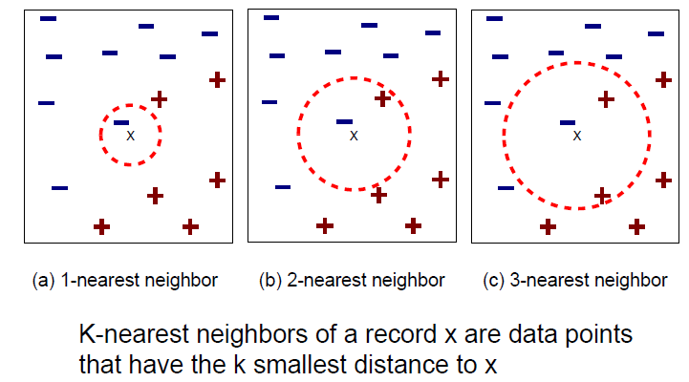
Supervised Learning: Classification
How KNN Works:

Slide 7
Supervised Learning: Classification
Example of KNN:
Height (cm) | Weight (KG) | Class
167 | 51 | Underweight
182 | 62 | Normal
176 | 69 | Normal
173 | 64 | Normal
172 | 65 | Normal
174 | 56 | Underweight
169 | 58 | Normal
173 | 57 | Normal
170 | 55 | Normal
170 | 57 | ?

Slide 8
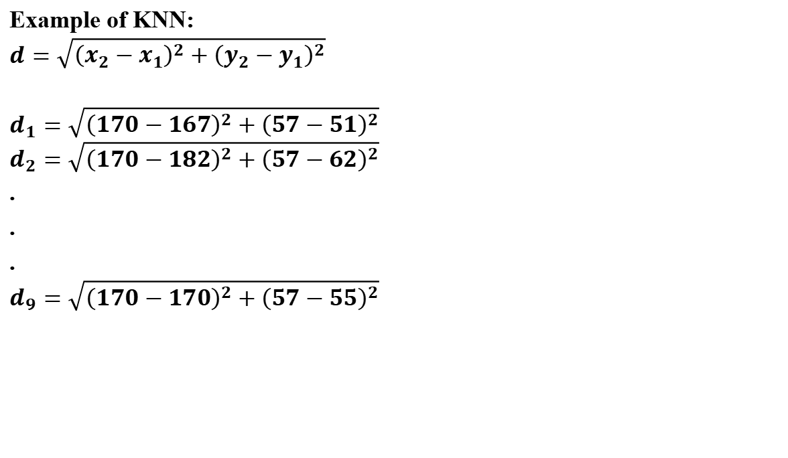
Supervised Learning: Classification
Example of KNN:
$$d=\sqrt{{\left(x_{2}−x_{1}\right)}^{2}+{\left(y_{2}−y_{1}\right)}^{2}}$$
$$d_{1}=\sqrt{{\left(170−167\right)}^{2}+{\left(57−51\right)}^{2}}$$
$$d_{2}=\sqrt{{\left(170−182\right)}^{2}+{\left(57−62\right)}^{2}}$$
.
.
.
$$d_{9}=\sqrt{{\left(170−170\right)}^{2}+{\left(57−55\right)}^{2}}$$
Height (cm) | Weight (KG) | Class
167 | 51 | Underweight
182 | 62 | Normal
176 | 69 | Normal
173 | 64 | Normal
172 | 65 | Normal
174 | 56 | Underweight
169 | 58 | Normal
173 | 57 | Normal
170 | 55 | Normal
170 | 57 | ?

Slide 9
Supervised Learning: Classification
Example of KNN:
Height (cm) | Weight (KG) | Class | d
167 | 51 | Underweight | 6.7
182 | 62 | Normal | 13
176 | 69 | Normal | 13.4
173 | 64 | Normal | 7.6
172 | 65 | Normal | 8.2
174 | 56 | Underweight | 4.1
169 | 58 | Normal | 1.4
173 | 57 | Normal | 3
170 | 55 | Normal | 2
170 | 57 | ?

Slide 10
Supervised Learning: Classification
Example of KNN:
Height (cm) | Weight (KG) | Class | d | Rank
169 | 58 | Normal | 1.4 | 1
170 | 55 | Normal | 2 | 2
173 | 57 | Normal | 3 | 3
174 | 56 | Underweight | 4.1 | 4
167 | 51 | Underweight | 6.7 | 5
173 | 64 | Normal | 7.6 | 6
172 | 65 | Normal | 8.2 | 7
182 | 62 | Normal | 13 | 8
176 | 69 | Normal | 13.4 | 9
170 | 57 | ?

Slide 11
Supervised Learning: Classification
Example of KNN:
Height (cm) | Weight (KG) | Class | d | Rank
169 | 58 | Normal | 1.4 | 1
170 | 55 | Normal | 2 | 2
173 | 57 | Normal | 3 | 3
174 | 56 | Underweight | 4.1 | 4
167 | 51 | Underweight | 6.7 | 5
173 | 64 | Normal | 7.6 | 6
172 | 65 | Normal | 8.2 | 7
182 | 62 | Normal | 13 | 8
176 | 69 | Normal | 13.4 | 9
170 | 57 | ?
K=3

Slide 12
Supervised Learning: Classification
Example of KNN:
Height (cm) | Weight (KG) | Class | d | Rank
169 | 58 | Normal | 1.4 | 1
170 | 55 | Normal | 2 | 2
173 | 57 | Normal | 3 | 3
174 | 56 | Underweight | 4.1 | 4
167 | 51 | Underweight | 6.7 | 5
173 | 64 | Normal | 7.6 | 6
172 | 65 | Normal | 8.2 | 7
182 | 62 | Normal | 13 | 8
176 | 69 | Normal | 13.4 | 9
170 | 57 | ?
K=4

Slide 13
Supervised Learning: Classification
Example of KNN:
Height (cm) | Weight (KG) | Class | d | Rank
169 | 58 | Normal | 1.4 | 1
170 | 55 | Normal | 2 | 2
173 | 57 | Normal | 3 | 3
174 | 56 | Underweight | 4.1 | 4
167 | 51 | Underweight | 6.7 | 5
173 | 64 | Normal | 7.6 | 6
172 | 65 | Normal | 8.2 | 7
182 | 62 | Normal | 13 | 8
176 | 69 | Normal | 13.4 | 9
170 | 57 | ?
K=5

Slide 14
Supervised Learning: Classification
Disadvantages of KNN:
Computationally Expensive: As the size of the dataset increases, the algorithm becomes slow because it has to calculate the distance for each test point with every training point.
Sensitive to Noisy Data: Outliers or irrelevant features can significantly affect predictions.
Feature Scaling Required: Since KNN relies on distance calculations, features must be scaled properly to prevent features with larger ranges from dominating the distance calculation.
Memory-Intensive: The algorithm needs to store the entire training dataset, making it less memory-efficient for large datasets.

Slide 15
Supervised Learning: Classification
Disadvantages of KNN:
Computationally Expensive: As the size of the dataset increases, the algorithm becomes slow because it has to calculate the distance for each test point with every training point.
Sensitive to Noisy Data: Outliers or irrelevant features can significantly affect predictions.
Feature Scaling Required: Since KNN relies on distance calculations, features must be scaled properly to prevent features with larger ranges from dominating the distance calculation.
Memory-Intensive: The algorithm needs to store the entire training dataset, making it less memory-efficient for large datasets.

Slide 16
KNN Use Cases (Best)
Target Application: E-Commerce Recommendation Systems & Content Retrieval KNN thrives in environments where the primary objective is finding similar entities based on historical attributes or user behavior, operating perfectly as a "lazy" learner.
Core Justifications:
Zero Training Latency: The model requires no explicit retraining epochs. As soon as a new product or user is added to the database, it is instantly available in the nearest-neighbor search space.
Intuitive Mimicry of Human Logic: KNN mimics natural association. If a user likes a specific sci-fi movie, the algorithm simply calculates the distance to find the 5 movies with the most identical genre, director, and rating attributes.
Dynamic Adaptation: The model’s behavior shifts organically as the underlying data distribution changes over time, without requiring manual model weight updates.
Additional Examples:
Real estate platforms finding "Similar properties in this neighborhood" based on a user's current listing view.
Genetic sequence matching in bioinformatics.

Slide 17
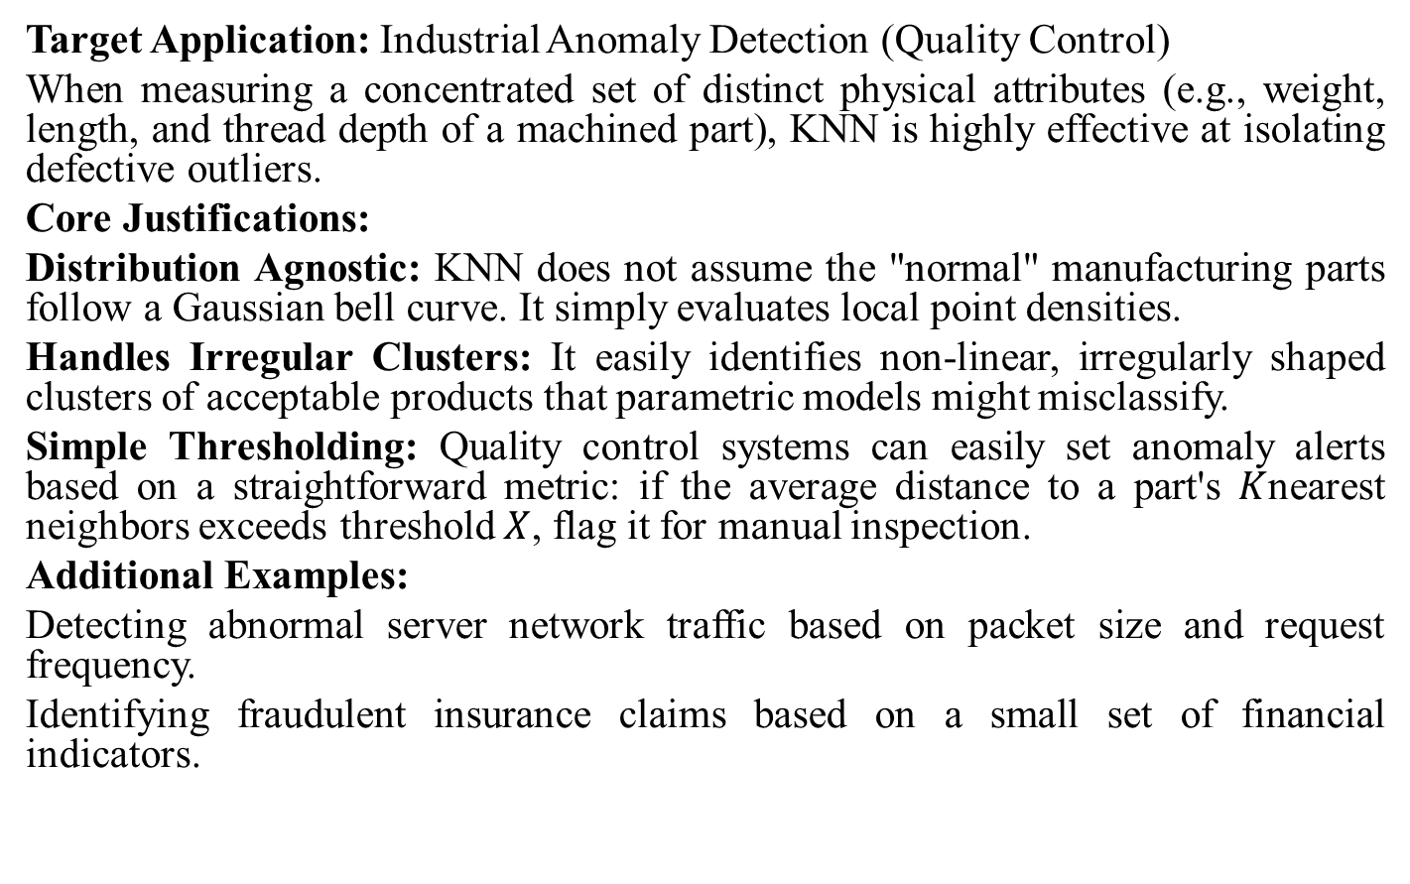
KNN Use Cases (Best)
Target Application: Industrial Anomaly Detection (Quality Control)
When measuring a concentrated set of distinct physical attributes (e.g., weight, length, and thread depth of a machined part), KNN is highly effective at isolating defective outliers.
Core Justifications:
Distribution Agnostic: KNN does not assume the "normal" manufacturing parts follow a Gaussian bell curve. It simply evaluates local point densities.
Handles Irregular Clusters: It easily identifies non-linear, irregularly shaped clusters of acceptable products that parametric models might misclassify.
Simple Thresholding: Quality control systems can easily set anomaly alerts based on a straightforward metric: if the average distance to a part's $K$nearest neighbors exceeds threshold $X$, flag it for manual inspection.
Additional Examples:
Detecting abnormal server network traffic based on packet size and request frequency.
Identifying fraudulent insurance claims based on a small set of financial indicators.

Slide 18
KNN Use Cases (Worst)
Target Application: High-Dimensional Text Classification (NLP)
Text data requires vectorizing documents into thousands of dimensions (e.g., TF-IDF matrices). KNN suffers catastrophic performance degradation in these spaces due to the "Curse of Dimensionality."
Core Justifications:
Distance Metric Breakdown: In highly dimensional spaces, the volume of the feature space expands exponentially. The mathematical distance between the nearest neighbor and the farthest neighbor converges, rendering similarity calculations meaningless.
Severe Sparsity: High-dimensional spaces are incredibly empty. Finding a genuinely "close" neighbor requires an exponentially massive, often computationally impossible, dataset.
Memory Exhaustion: Storing hundreds of thousands of dense document vectors in active RAM to perform real-time distance calculations for every single query is highly inefficient and expensive.
Additional Examples:
Classifying high-resolution medical MRI scans without prior dimensionality reduction.
Microarray gene expression analysis with tens of thousands of features.

Slide 19
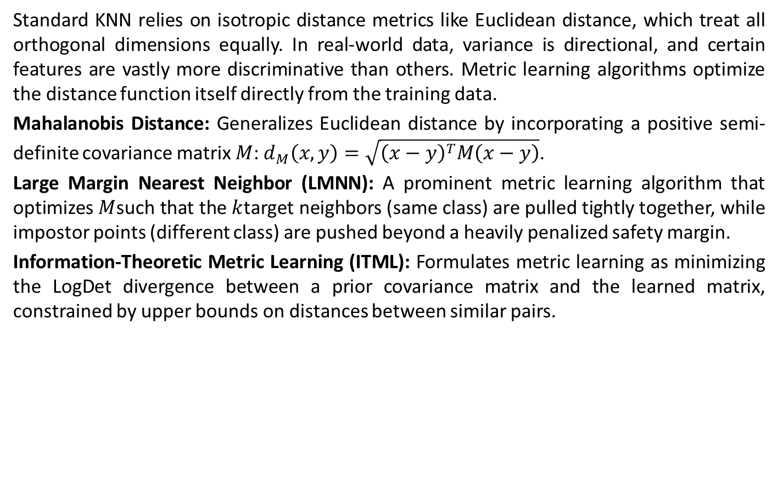
Metric Learning & Mahalanobis Distance Optimization
Standard KNN relies on isotropic distance metrics like Euclidean distance, which treat all orthogonal dimensions equally. In real-world data, variance is directional, and certain features are vastly more discriminative than others. Metric learning algorithms optimize the distance function itself directly from the training data.
Mahalanobis Distance: Generalizes Euclidean distance by incorporating a positive semi-definite covariance matrix $M$: $d_{M}\left(x,y\right)=\sqrt{{\left(x−y\right)}^{T}M\left(x−y\right)}$.
Large Margin Nearest Neighbor (LMNN): A prominent metric learning algorithm that optimizes $M$such that the $k$target neighbors (same class) are pulled tightly together, while impostor points (different class) are pushed beyond a heavily penalized safety margin.
Information-Theoretic Metric Learning (ITML): Formulates metric learning as minimizing the LogDet divergence between a prior covariance matrix and the learned matrix, constrained by upper bounds on distances between similar pairs.

Slide 20
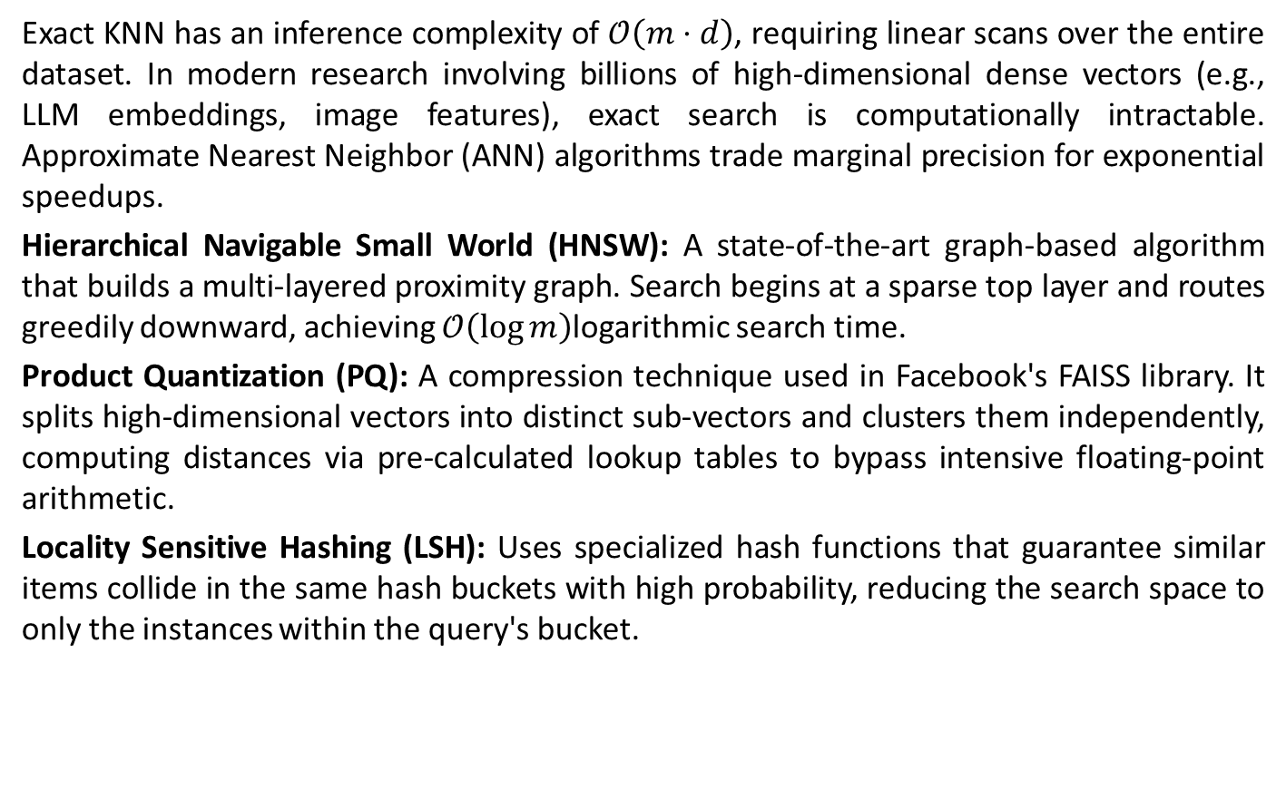
Approximate Nearest Neighbors (ANN) in High Dimensions
Exact KNN has an inference complexity of $𝒪\left(m⋅d\right)$, requiring linear scans over the entire dataset. In modern research involving billions of high-dimensional dense vectors (e.g., LLM embeddings, image features), exact search is computationally intractable. Approximate Nearest Neighbor (ANN) algorithms trade marginal precision for exponential speedups.
Hierarchical Navigable Small World (HNSW): A state-of-the-art graph-based algorithm that builds a multi-layered proximity graph. Search begins at a sparse top layer and routes greedily downward, achieving $𝒪\left(\log{m}\right)$logarithmic search time.
Product Quantization (PQ): A compression technique used in Facebook's FAISS library. It splits high-dimensional vectors into distinct sub-vectors and clusters them independently, computing distances via pre-calculated lookup tables to bypass intensive floating-point arithmetic.
Locality Sensitive Hashing (LSH): Uses specialized hash functions that guarantee similar items collide in the same hash buckets with high probability, reducing the search space to only the instances within the query's bucket.

Slide 21
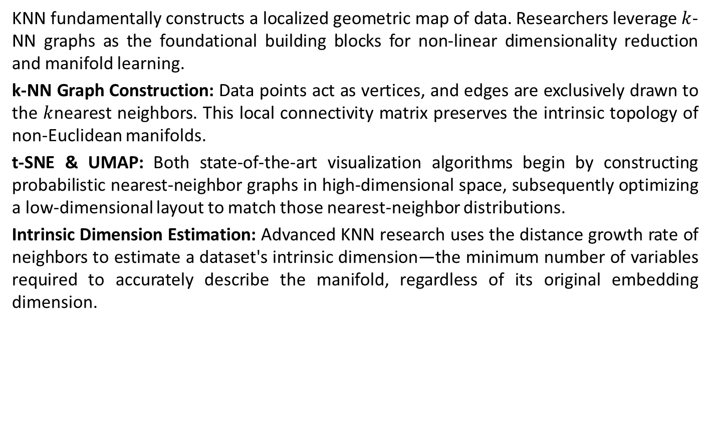
Topological & Manifold Learning Extensions
KNN fundamentally constructs a localized geometric map of data. Researchers leverage $k$-NN graphs as the foundational building blocks for non-linear dimensionality reduction and manifold learning.
k-NN Graph Construction: Data points act as vertices, and edges are exclusively drawn to the $k$nearest neighbors. This local connectivity matrix preserves the intrinsic topology of non-Euclidean manifolds.
t-SNE & UMAP: Both state-of-the-art visualization algorithms begin by constructing probabilistic nearest-neighbor graphs in high-dimensional space, subsequently optimizing a low-dimensional layout to match those nearest-neighbor distributions.
Intrinsic Dimension Estimation: Advanced KNN research uses the distance growth rate of neighbors to estimate a dataset's intrinsic dimension—the minimum number of variables required to accurately describe the manifold, regardless of its original embedding dimension.

Slide 22
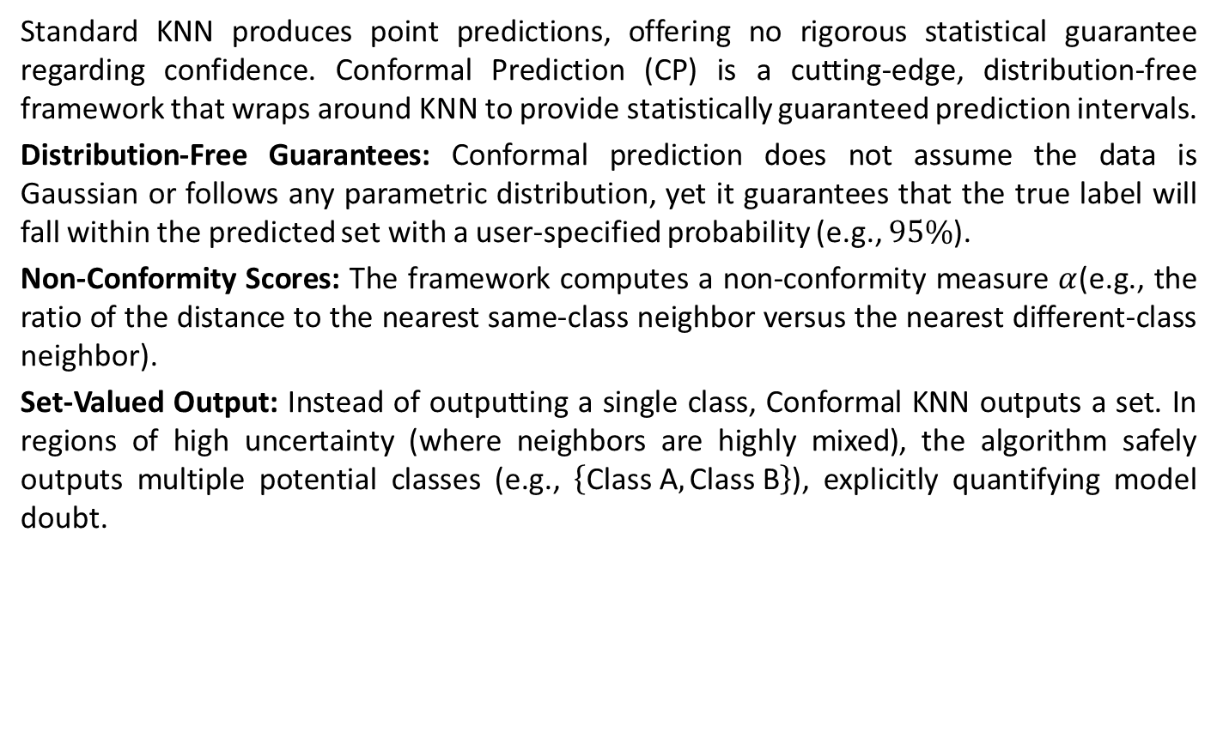
Conformal Prediction & Set-Valued KNN
Standard KNN produces point predictions, offering no rigorous statistical guarantee regarding confidence. Conformal Prediction (CP) is a cutting-edge, distribution-free framework that wraps around KNN to provide statistically guaranteed prediction intervals.
Distribution-Free Guarantees: Conformal prediction does not assume the data is Gaussian or follows any parametric distribution, yet it guarantees that the true label will fall within the predicted set with a user-specified probability (e.g., $95\%$).
Non-Conformity Scores: The framework computes a non-conformity measure $α$(e.g., the ratio of the distance to the nearest same-class neighbor versus the nearest different-class neighbor).
Set-Valued Output: Instead of outputting a single class, Conformal KNN outputs a set. In regions of high uncertainty (where neighbors are highly mixed), the algorithm safely outputs multiple potential classes (e.g., $\left\{\text{Class A},\text{Class B}\right\}$), explicitly quantifying model doubt.

Slide 23
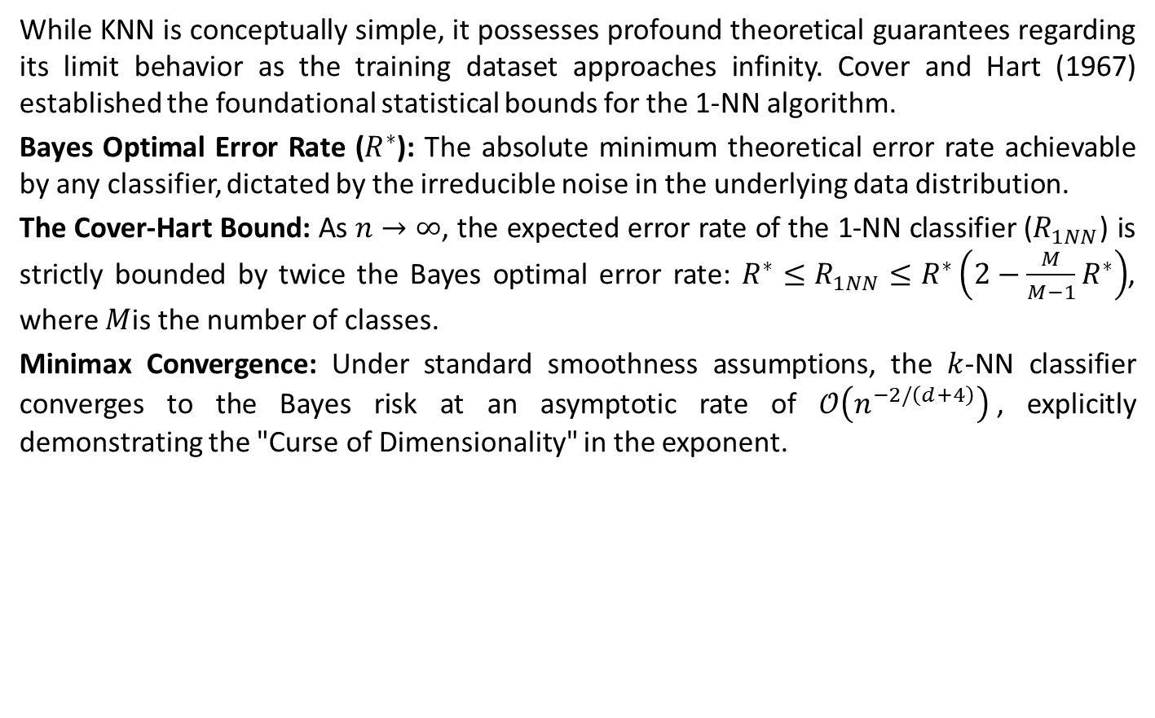
Asymptotic Risk & The Cover-Hart Theorem
While KNN is conceptually simple, it possesses profound theoretical guarantees regarding its limit behavior as the training dataset approaches infinity. Cover and Hart (1967) established the foundational statistical bounds for the 1-NN algorithm.
Bayes Optimal Error Rate ($R^{∗}$): The absolute minimum theoretical error rate achievable by any classifier, dictated by the irreducible noise in the underlying data distribution.
The Cover-Hart Bound: As $n→∞$, the expected error rate of the 1-NN classifier ($R_{1NN}$) is strictly bounded by twice the Bayes optimal error rate: $R^{∗}≤R_{1NN}≤R^{∗}\left(2−\frac{M}{M−1}R^{∗}\right)$, where $M$is the number of classes.
Minimax Convergence: Under standard smoothness assumptions, the $k$-NN classifier converges to the Bayes risk at an asymptotic rate of $𝒪\left(n^{−2/\left(d+4\right)}\right)$, explicitly demonstrating the "Curse of Dimensionality" in the exponent.

Slide 24
Supervised Learning: Classification
KNN Code:
https://colab.research.google.com/drive/10AAxz1yXJNIR-PQcXoaAPPTkrFHs6efT?usp=sharing
KNN Code 2:
https://colab.research.google.com/drive/1MKAxFdlYdecqqSiYF8pgO4IRQYwDcwEm?usp=sharing

